Slide 1



COMPUTER NETWORKS Computer Engineering.

Slide 2



PEERCODE: ONLINE CODING JUDGE
Members:
Shrishail Kumbhar-TECOC329
Aniket Dhole-TECOC314
Mohit Gandhi-TECOC316
Harsh Singhal-TECOC361

Slide 3
Problem Definition
To make an Online Code Judge System which will allow users to code Online and get results immediately.
To provide Interview and Practice Coding Questions to Ace Algorithm and Data Structures Skills.
To provide User to create a group and solve Problems to promote Peer Learning.
There will also be Weekly Contests on our Platform so that users could get insight on how real Coding Interview Rounds work.

Slide 4
Motivation
“Tell me and I forget. Teach me and I remember. Involve me and I learn”- Benjamin Franklin .
Building Up Coding Platform for College would Help Students / Faculties to come together and Work Under One Roof .
Help Students improve Coding for Placements through Weekly Coding Contests .
Promote And Run Competitive Programming Campaign Throughout Campus.

Slide 5
Objectives
To Facilitate the idea of practicing coding questions for coding interviews and to improve how to approach to a problem.
As we focus more on Peer Learning ,this would be the Platform for users which will provide this Facility.
It will provide the users to practice coding they learn from other website API’s like Udemy, Coursera and even of their own practice.
This Product can be utilized by anyone. And also teachers can evaluate students for their coding skills.
This product is compatible on Windows, Ubuntu, Mac etc.
Peer to peer Learning.

Slide 6
Literature Survey
1. Design and Implementation of Online Automatic Judging System ( Haohui Liang)
https://iopscience.iop.org/article/10.1088/1755-1315/69/1/012091/pdf
2. A Survey on Online Judge Systems and Their Applications (Szymon Wasik,Macij Antczak)
https://arxiv.org/pdf/1710.05913.pdf
3. The Costs and Benefits of Pair Programming (Alistair Cockburn, Laurie Williams)
https://collaboration.csc.ncsu.edu/laurie/Papers/XPSardinia.PDF
4. On Automated Grading of Programming Assignments in an Academic Institution (Brenda Cheanga, Andy Kurnia)
https://www.cs.tufts.edu/~nr/cs257/archive/brenda-cheang/automated-grading.pdf
5.CS50 Sandbox Secure Execution of Untrusted Code (David J Malan)
https://cs.harvard.edu/malan/publications/fp245-malan.pdf

Slide 7
Proposed Work(Architecture and technology)
Frontend: React, JavaScript, HTML, CSS.
React: For easy testing of HTML and CSS code
JavaScript : To communicate between Frontend and Backend
HTML and CSS, Bootstrap: For Frontend
Backend: API,NODEJS
1. API calls : To run user code efficiently on Online Compilers
2. NodeJS : To communicate between API and Web
Storage and Hosting: Firebase, SQL/Mongo DB
1. Firebase : For Authentication, Database and Hosting
2. SQL/MongoDB : To format database easily
Networking: TCP/IP, WebRTC, HTTPS Requests
1. HTTPS Requests: To send HTTP Requests between backend and Frontend
2. TCP/IP : For creating Peer to Peer Groups for multiple users
3. WebRTC: Connecting multiple user to same Code Editor(P2P)

Slide 8
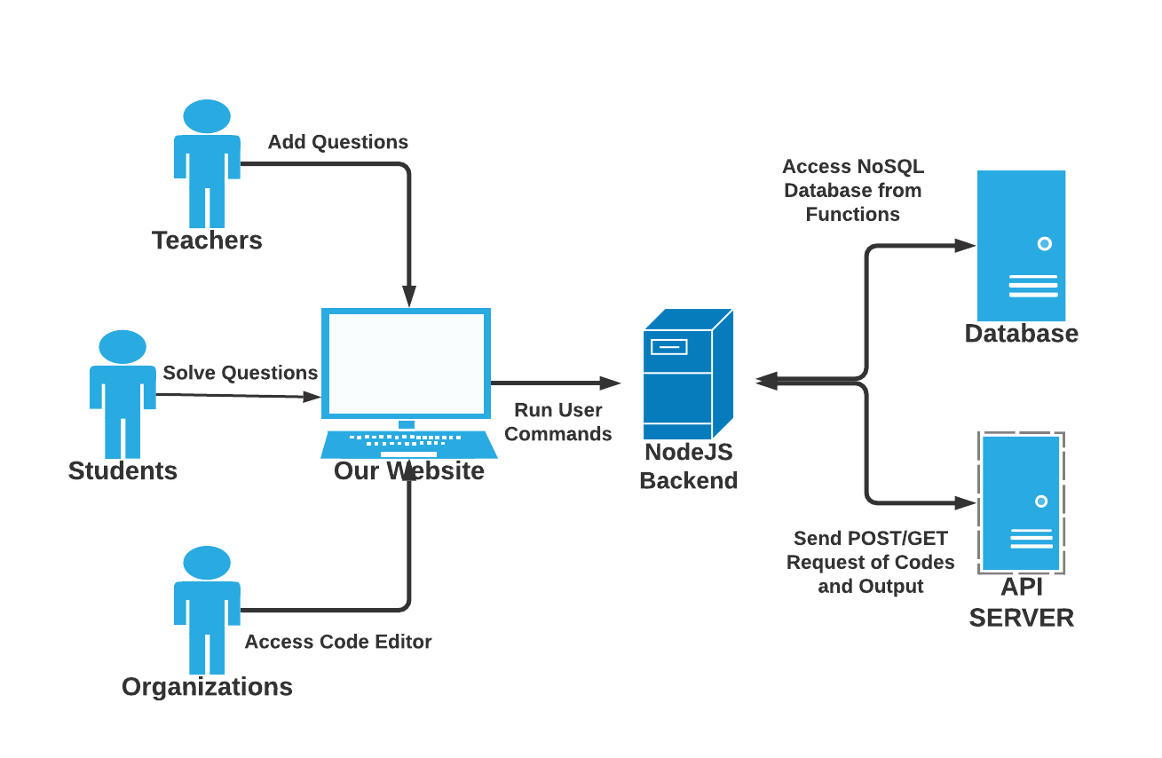
Project Overview Diagram

Slide 9
THANK YOU

